Slide 1
REGENERATIVE MEDICINE, THERAPEUTIC CLONING & GENE THERAPY

Slide 2
Introduction
Recombinant DNA involves combining the DNA of two different organisms
Free-living organisms that have foreign gene inserted into them are called transgenic animals and plants

Slide 3
Steps involved in the r-DNA production
Recombinant DNA (r DNA) contains DNA from two different sources
To make r-DNA, select a vector
A vector is a plasmid or virus used to transfer foreign genetic material into a cell
A plasmid is a small accessory ring of DNA in the cytoplasm of bacteria
Plasmids were discovered in research on reproduction of intestinal bacteria Escherichia coli

Slide 4
CONT.
6. Introduction of foreign DNA into vector DNA to produce rDNA requires two enzymes
Restriction enzyme is a bacterial enzyme that stops viral reproduction by cleaving viral DNA and it also used to cut DNA at specific points during production of r DNA
DNA ligase enzyme seals DNA fragments into the gap created by the restriction enzyme
7.Restriction enzymes cleave vector (plasmid) and foreign (human) DNA
Cleaving DNA makes DNA fragments ending in short single-stranded segments (sticky ends)
Sticky ends allow insertion of foreign DNA into vector DNA

Slide 5
Cont.
8. The foreign gene is sealed into the vector DNA by DNA ligase
Treated cells take up plasmids and then bacteria and plasmids reproduce
Eventually, there are many copies of the plasmid and many copies of the foreign gene
When DNA splicing is complete, an r-DNA (recombinant DNA) is formed

Slide 6
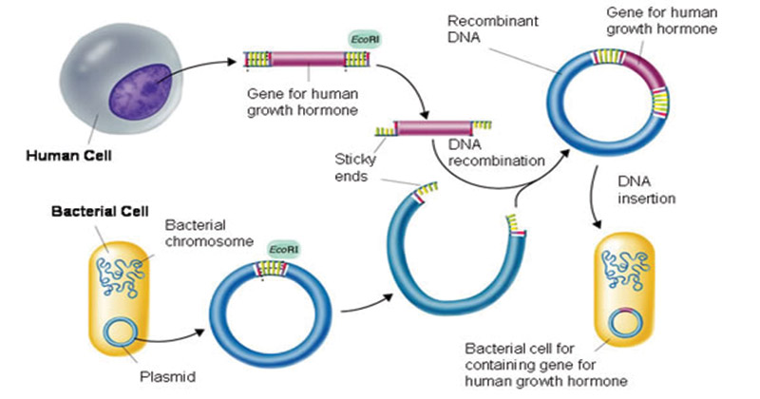

Slide 7
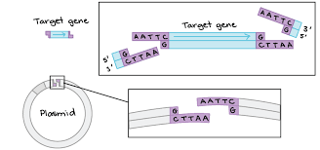

Slide 8
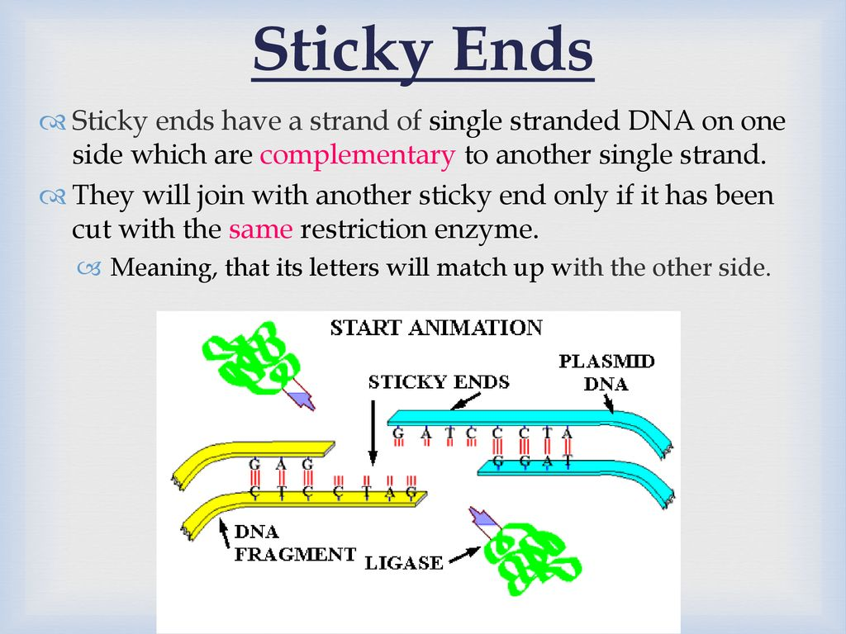

Slide 9
Applications of r-DNA
Improved crops (drought & heat resistance)
Recombinant vaccines (i.e. Hepatitis B)
Prevention and cure of sickle cell anemia, cystic fibrosis
Production of clotting factors, insulin and recombinant medicines
Production of insecticidal resistant plants
Somatic and germ line therapy

Slide 10
Regenerative medicine- cloning
Tissue engineering is a combination of cellular engineering with suitable biochemical and physico-chemical factors to improve or replace the biological functions
Somatic-cell nuclear transfer (SCNT) is a laboratory technique for creating a clone embryo with a donor nucleus
It can be used in embryonic stem cell research in regenerative medicine where it has been referred to as “ therapeutic cloning”
Cells in an early human embryo, however, are “totipotent or pluripotent” – they can form any part of the human body. Such cells can be cultured indefinitely as embryonic stem cell lines.

Slide 11
Process of Somatic-cell nuclear transfer
The nucleus of a somatic cell is removed and kept in host’s egg cell nucleus is removed and discarded
Lone nucleus and an empty deprogrammed egg cell were fused
After, insertion of nucleus into egg, the lone (somatic cell) nucleus is reprogrammed by the host egg cell
The egg cell with somatic cell’s nucleus is stimulated with shock and it will begin to divide
After many mitotic divisions, single cell forms a blastocyst (early stage embryo with about 100 cells) with identical DNA to organism

Slide 12
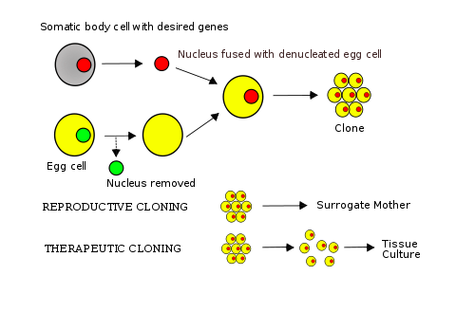

Slide 13
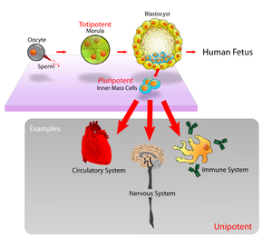
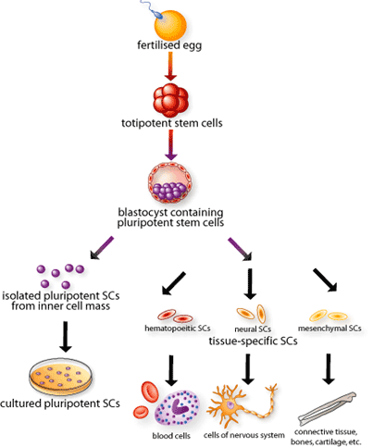

Slide 14
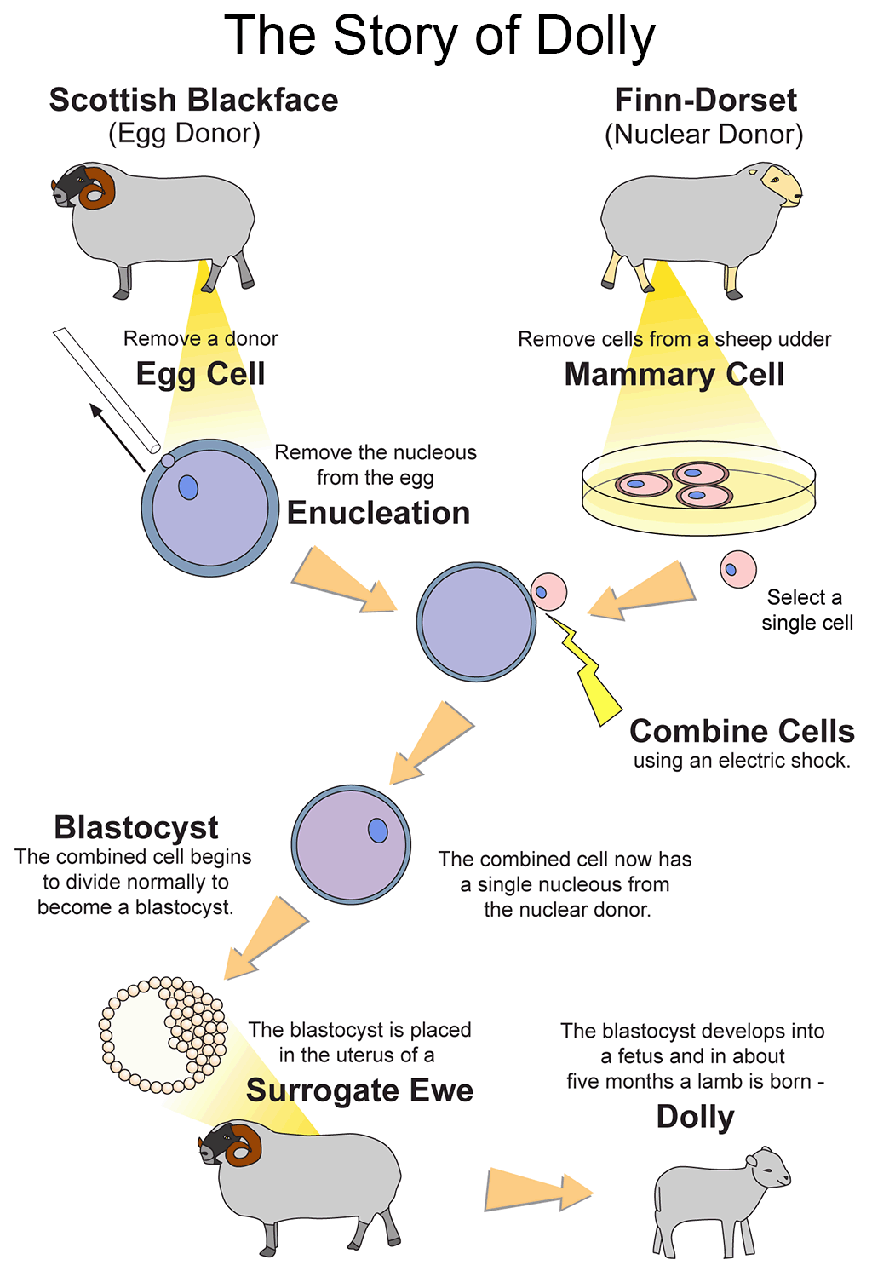
Example
Dolly- sheep was produced by somatic cell nuclear transplantation cloning which involves removing the nucleus of an egg and replacing it with diploid nucleus of somatic cell.

Slide 15
Gene Therapy
Gene therapy is the use of DNA as pharmaceutical agent to treat diseases.
DNA can be used to supplement or alter genes within an individual’s cells as a therapy to treat disease
Gene therapy involves using DNA that encodes a functional, therapeutic gene to replace a mutated gene
In gene therapy, DNA encodes a therapeutic protein and it is packaged within a ‘vector’ which is used to get the DNA inside cells within the body
DNA becomes expressed by cell machinery resulting in the production of therapeutic protein, which in turn treats the patient’s disease

Slide 16
Types Of Gene Therapy
Gene therapy can be classified into two:
Somatic gene therapy:
In this therapy, therapeutic genes are transferred into the somatic cells or body of patient
Any modifications and effects will be restricted to individual patient only and will not be inherited by patient’s offspring or later generations

Slide 17
CONT.
Germ line gene therapy:
In this technique, germ cells (i.e. sperm or eggs) are modified by the introduction of functional genes, which are integrated into their genomes
This allows the therapy to be heritable and passed on to later generations

Slide 18
THANK YOU

